Slide 1
Teaching Advanced Excel Skills and Analytical Techniques in an Introductory Finance Course
FMA Innovation In Teaching Session
William O’Brien
University of Illinois at Chicago
October 20, 2020

Slide 2
Dilemma for Students
Beginning of 1st year
End of 4th year/
graduation
Internship
Gen Eds
Intro to accounting and economics
Internship interviews
Post-grad job
interviews
Intro to finance
Prerequisites push intro finance to late 2nd/early 3rd year
Internship interviews begin in beginning of 3rd year
For many students, the intro finance class needs to deliver skills and knowledge that can land students an internship and succeed in that internship.

Slide 3
Dilemma for Instructors
Yes
This area is the goal! How can we provide work to students that is:
Practical
Adaptable
Hard to cheat/game
Easy to grade
Attractive to employers
Multiple choice test questions
Quizzes/tests in general
Implementable? (given large class sizes and cheating concerns)
Case studies (issues with class size, availability of online answers)
(academically honest) project work outside of classroom
Open-ended questions that leverage analytic and technical skills
No
Low
Usefulness of material to students?
High

Slide 4
My attempt to solve this problem:
Along with the “normal” intro to corporate finance curriculum, I created a parallel curriculum that trains students on Microsoft Excel.
First half of semester:
Learning & mastering Excel tools (I focus on tools I used most often in my pre-academic career)
Excel Curriculum
Second half of semester:
Applying those tools for financial analysis
Finance Curriculum
Notes:
Motivation for my teaching innovation:
-cycle time for finance students to market
Prerequisites, transfer students
Need to make an impact in first finance course
- x and y axis : teacher workload vs. practical use for students
Mult choice test
Essay questions
Calculation problems
Open ended case studies
- z axis...hard easy for student to cheat (move it backwards and forwards
For advanced topics, flipped classrooms, case based stuff, Bloomberg terminals, etc. all ok
For an intro class, with non-finance folks, no pre-existing finance knowledge assumed...what can you do?
Big classes in early years, smaller classes in later years
BIG FOCUS – Excel integration in as many parts of the course as you can (Excel assignment “answer keys”, bond calculator, grade calculator, investment portfolio calculator
Excel as the “Swiss army knife” of corporate America...reporting tool, database tool, analysis tool, financial calculator, modeling tool (show different knife gadgets as different Excel uses)
Question 4 - ratio memorization is meaningless without context - trend? Competitors? Etc.
For presentation videos, use a randomized for name lookups and ids to show the impact of different info in the answers
Make sure screen shots are LARGE
Note how few files it takes to get up and running
Show arrows/flow chart of semester flow of work (starts out red and blue, one element becomes purple)
Each analysis assignment designed to overcome a teaching obstacle (how to apply ratios in a meaningful context, how to construct DYNAMIC pro formas and do projections, how to illustrate uncertainty in finance, introducing complex problems with multiple methods without spoon feeding ) and provide specific tools (v and hlookups and concatenating, goalseeking, macros, and IF/pivot to construct rentention ratios and using cell references, respectively)

Slide 5

Excel: the “Swiss Army Knife” of Analytics
@Risk = circular saw
Risk Modeling
Reporting and Dashboards
Financial Calculator
Capital Budgeting Project Tracking and Management
Ad Hoc Data Analysis
Big Data (well, “medium” data)
Forecasting
R, SAS, Stata = Cordless Drill

Slide 6
Teaching Structure and Timeline
First half of semester:
Learning & mastering Excel tools (I focus on tools I used most often in my pre-academic career)
Cell Referencing
VLOOKUP
Auto-filling cells
Pivot Tables
IF, SUMIF, COUNTIF
Dollar sign anchoring
Drop-down menus
Conditional formatting
Excel Curriculum
Goalseeking
Recording VB Macros
Random # generation
Concatenating text strings
Finance Curriculum
Corporations
Limited liability
Agency theory
Financial Markets
Financial statements
Cash flow analysis
TVM
Loan Types/Payments
Bond valuation
Stock valuation
Capital Structure
Risk and return

Slide 7
Creating the “right” data for the project
I created the Excel database using a “random name” generator from the internet to create ~4000 customers
Data by state, year, new vs. renewing customer, cancellation status, etc.
The goal: detailed, but intuitive and not overwhelming

Slide 8
1st Half of Semester –Excel Tools
Cell Referencing
VLOOKUP
Auto-filling cells
Pivot Tables
IF, SUMIF, COUNTIF
Dollar sign anchoring
Drop-down menus
Conditional formatting
Goalseeking
Recording VB Macros
Random # generation
Concatenating text strings

Slide 9
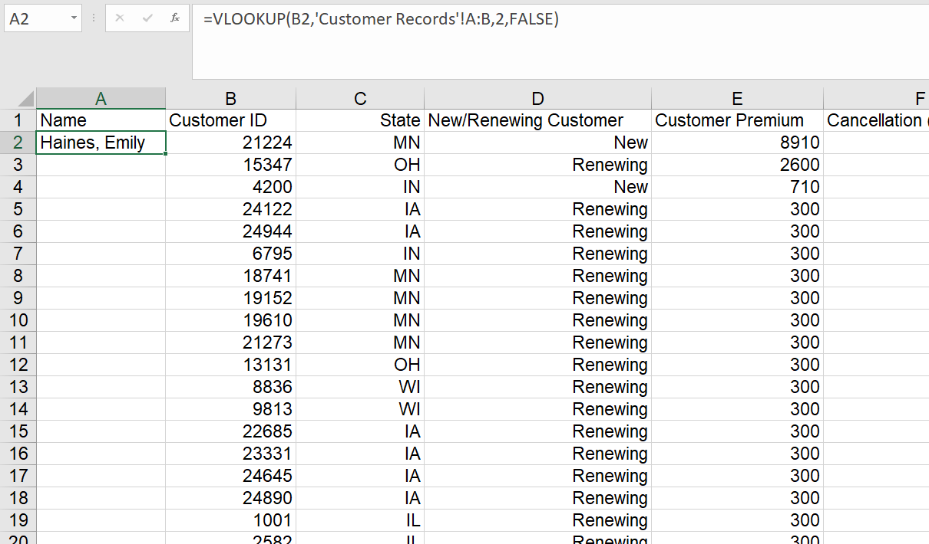
1st Half of Semester –Excel Tools
Cell Referencing
VLOOKUP
Auto-filling cells
Pivot Tables
IF, SUMIF, COUNTIF
Dollar sign anchoring
Drop-down menus
Conditional formatting
Goalseeking
Recording VB Macros
Random # generation
Concatenating text strings
First Assignment

Slide 10
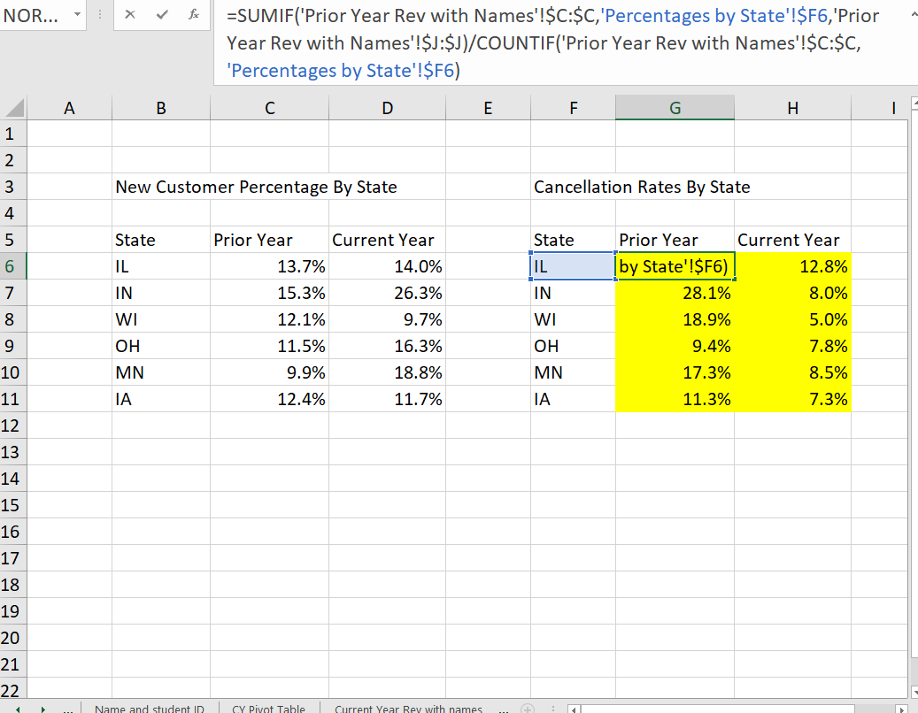
1st Half of Semester –Excel Tools
Cell Referencing
VLOOKUP
Auto-filling cells
Pivot Tables
IF, SUMIF, COUNTIF
Dollar sign anchoring
Drop-down menus
Conditional formatting
Goalseeking
Recording VB Macros
Random # generation
Concatenating text strings

Slide 11
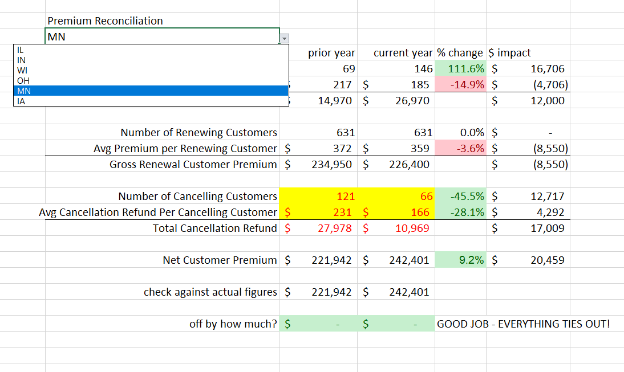
1st Half of Semester –Excel Tools
Cell Referencing
VLOOKUP
Auto-filling cells
Pivot Tables
IF, SUMIF, COUNTIF
Dollar sign anchoring
Drop-down menus
Conditional formatting
Goalseeking
Recording VB Macros
Random # generation
Concatenating text strings
Third Assignment

Slide 12
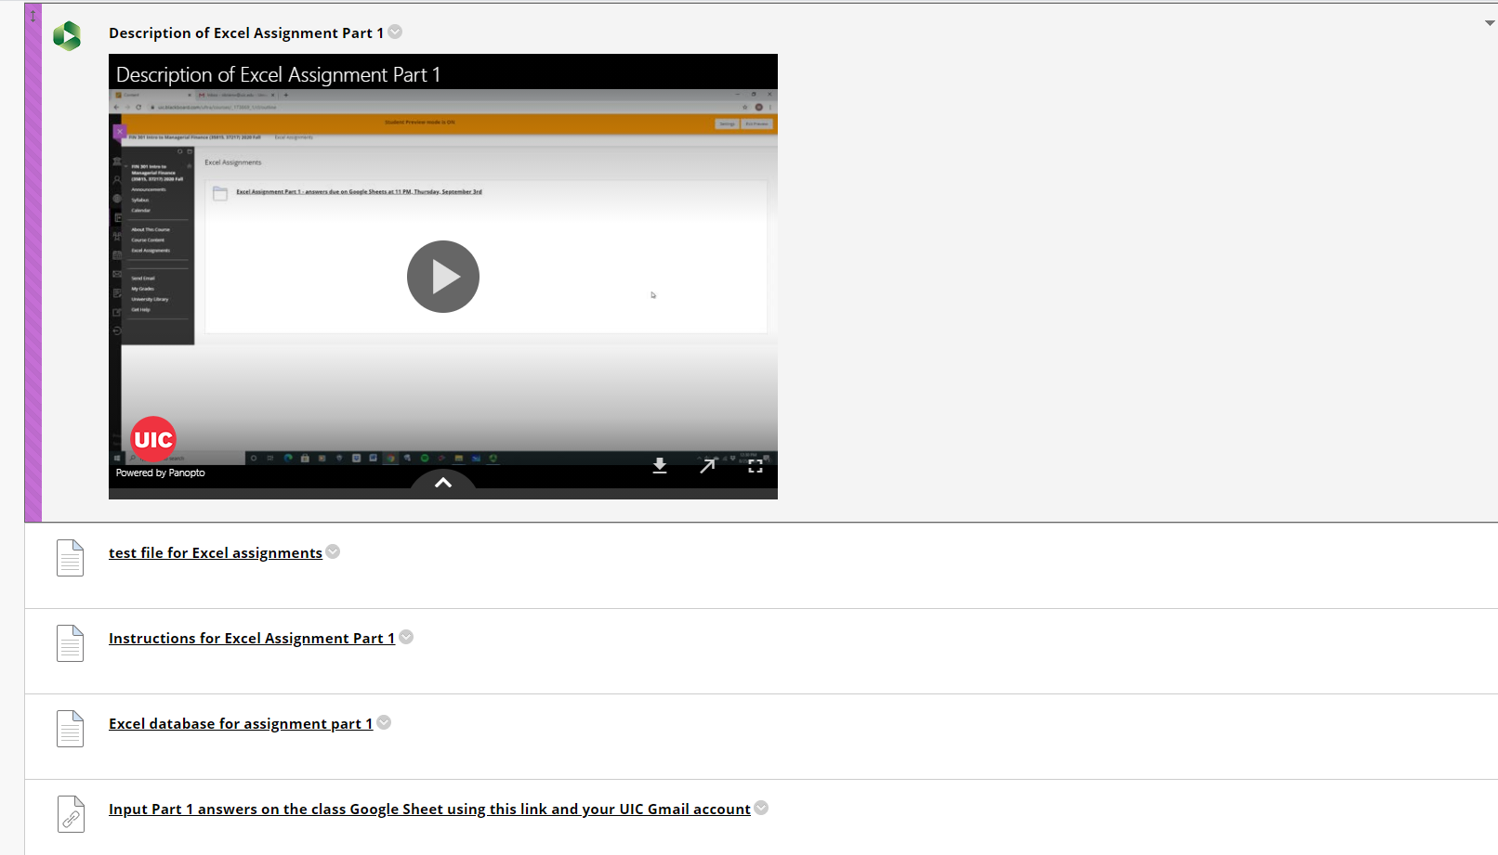

Slide 13
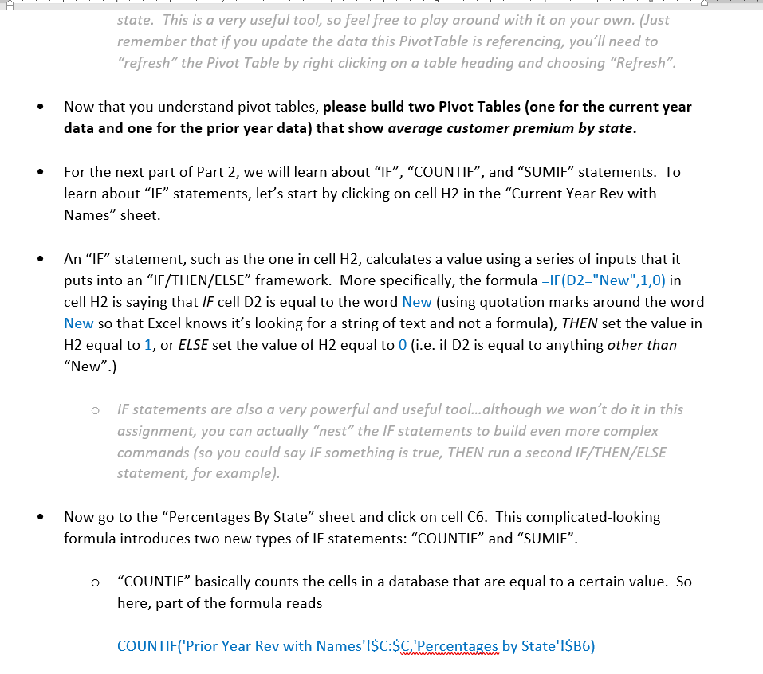
Instructions for Students
I created the instructions to be detailed, without necessarily giving away the answers.
Black, bold text: actual tasks
Blue text: formulas
Regular text: instructions
Grey text: “nice to know” but not essential for assignment
I think students learn more this way than watching a video.

Slide 14
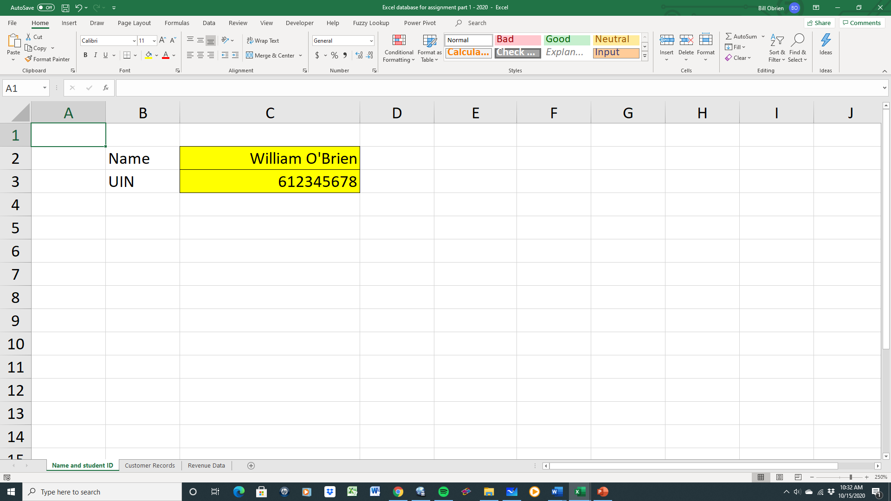
On the first sheet of the database, students enter name and student ID (I’ll come back to this!)

Slide 15
How It Works, and How it Deters Cheating
By putting in their name/student ID, students get a unique answer
Students are asked for two or three pieces of information based on these dynamic cells and enter their answers in a google sheet
Grading template reverse-engineers their answers and assigns scores accordingly

Slide 16
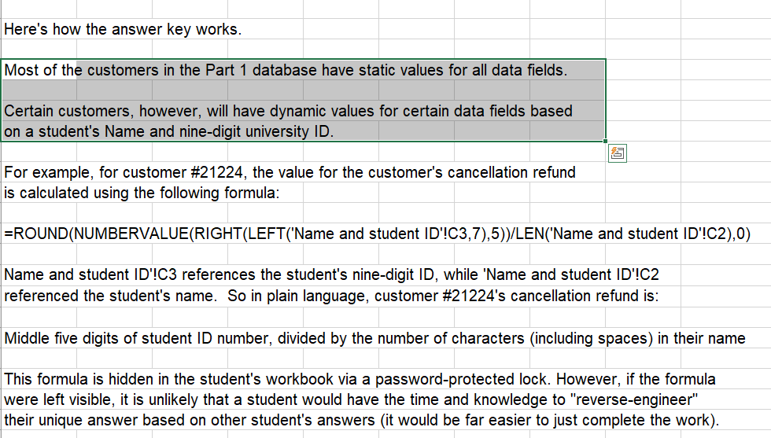
Guidance for instructors
Certain customers have (password-protected) formula-generated answers that are unique for each student!

Slide 17
Guidance for instructors

Slide 18
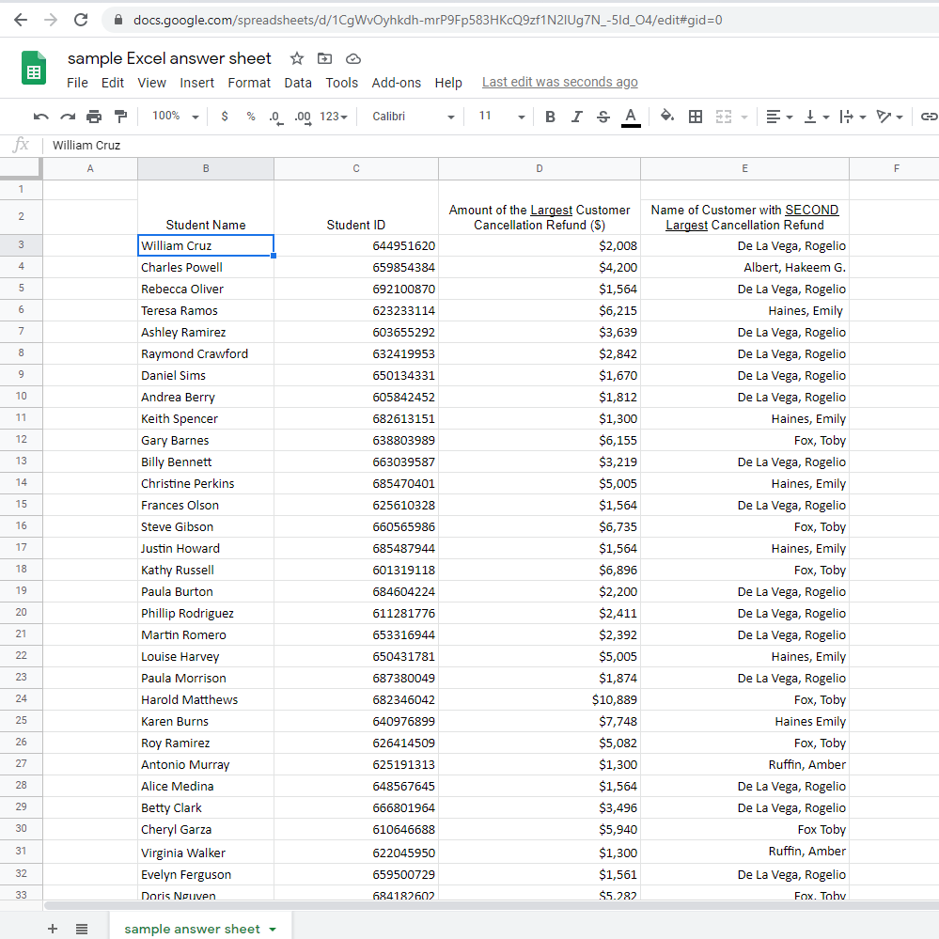
Submitting Answers
Students put their name and student ID (or just name if they choose) and two pieces of info from completed assignment.
Note that the student solutions are unique…very little is gained from seeing other students’ answers!

Slide 19
Teaching Structure and Timeline
Cell Referencing
VLOOKUP
Auto-filling cells
Pivot Tables
Second half of semester:
Applying those tools for financial analysis
IF, SUMIF, COUNTIF
Dollar sign anchoring
Drop-down menus
Conditional formatting
Excel Curriculum
Goalseeking
Recording VB Macros
Random # generation
Concatenating text strings
Capital Budgeting
Financial ratio analysis
Pro Formas
Payout Policy
Risk Modeling
EMH
Portfolio construction
WACC
NPV/IRR analysis
Finance Curriculum
Corporations
Limited liability
Agency theory
Financial Markets
Financial statements
Cash flow analysis
TVM
Loan Types/Payments
Bond valuation
Stock valuation
Capital Structure
Risk and return

Slide 20
2nd Half of Semester – Financial Analysis in Excel
Cell Referencing
VLOOKUP
Auto-filling cells
Pivot Tables
IF, SUMIF, COUNTIF
Dollar sign anchoring
Drop-down menus
Conditional formatting
Goalseeking
Recording VB Macros
Random # generation
Concatenating text strings
Application #1: Competitor comparison report
Finance Concept Reinforced:
To analyze financial ratios, you need context (comparisons, tradeoffs, etc.)

Slide 22
2nd Half of Semester – Financial Analysis in Excel
Cell Referencing
VLOOKUP
Auto-filling cells
Pivot Tables
IF, SUMIF, COUNTIF
Dollar sign anchoring
Drop-down menus
Conditional formatting
Goalseeking
Recording VB Macros
Random # generation
Concatenating text strings
Application #2: Pro Forma creation and growth rate targeting
Finance Concept(s) Reinforced:
How capital structure and capital budgeting decisions are dynamic and intertwined in firms

Slide 23
Notes:
for IGR, SGR, solve for growth rate given debt restriction, or Vice versa - also can use payout rate! For Tesla, answer to how much they can grow with current debt level is “they can’t”
Try different growth rates, show how you need to goalseek growth to zero

Slide 24
2nd Half of Semester – Financial Analysis in Excel
Cell Referencing
VLOOKUP
Auto-filling cells
Pivot Tables
IF, SUMIF, COUNTIF
Dollar sign anchoring
Drop-down menus
Conditional formatting
Goalseeking
Recording VB Macros
Random # generation
Concatenating text strings
Application #3 Dynamic Stress Tests of a Firm’s Financial Stability
Finance Concept(s) Reinforced:
A practical look at how to measure “risk” dynamically and the ideas behind bank stress-testing

Slide 25
Notes:
Show how you can build Macros to be scaled...”moving down one cell” won’t work, but inserting a row and moving everything else down endlessly can be repeated

Slide 26
2nd Half of Semester – Financial Analysis in Excel
Cell Referencing
VLOOKUP
Auto-filling cells
Pivot Tables
IF, SUMIF, COUNTIF
Dollar sign anchoring
Drop-down menus
Conditional formatting
Goalseeking
Recording VB Macros
Random # generation
Concatenating text strings
Application #4: Stock Price Analysis
Finance Concept Reinforced:
Link between future cash flow/discount rate news and daily price movements

Slide 27
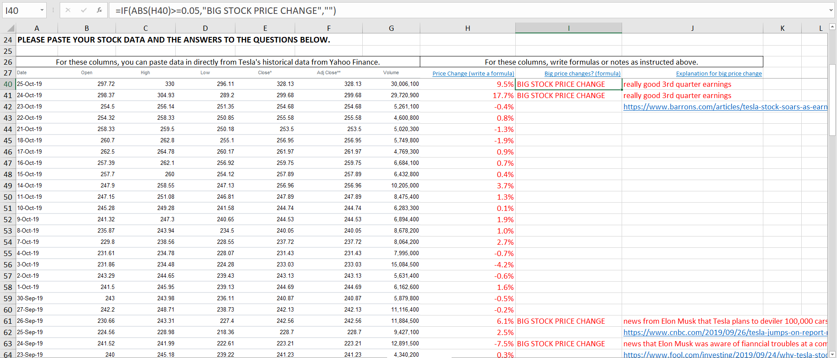

Slide 28
2nd Half of Semester – Financial Analysis in Excel
Cell Referencing
VLOOKUP
Auto-filling cells
Pivot Tables
IF, SUMIF, COUNTIF
Dollar sign anchoring
Drop-down menus
Conditional formatting
Goalseeking
Recording VB Macros
Random # generation
Concatenating text strings
Application #5: NPV Analysis
Finance Concept(s) Reinforced:
Single period profits =/= long-term shareholder value!

Slide 29
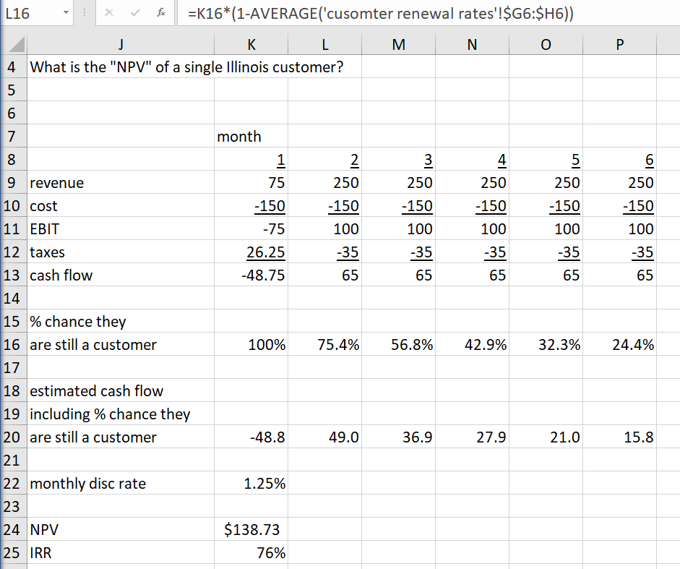
From SUMIF/COUNTIF/ Pivot Table training assignment

Slide 30
2nd Half of Semester – Financial Analysis in Excel
Cell Referencing
VLOOKUP
Auto-filling cells
Pivot Tables
IF, SUMIF, COUNTIF
Dollar sign anchoring
Drop-down menus
Conditional formatting
Goalseeking
Recording VB Macros
Random # generation
Concatenating text strings
Application #6: Simple Example of Stock Portfolio Diversification
Finance Concept(s) Reinforced:
Risk-reducing effects of diversification (without necessarily reducing returns)

Slide 32
2nd Half of Semester – Financial Analysis in Excel
Cell Referencing
VLOOKUP
Auto-filling cells
Pivot Tables
IF, SUMIF, COUNTIF
Dollar sign anchoring
Drop-down menus
Conditional formatting
Goalseeking
Recording VB Macros
Random # generation
Concatenating text strings
Application #7: Loan calculator
Finance Concept(s) Reinforced:
Comparison of different loan types (discount, interest only, amortized) and the effect of overpayment on principal and loan horizons

Slide 34
How On Earth Do I Implement This?
One “cost”: learning the relevant Excel skills (as an instructor) if they are new to you
  Can use the assignments/instructions themselves to do this!
Assignment answer keys come with guidance for students, job-aids for instructors (how answers are arrived at, with reverse-engineering already done)

Slide 35
Benefits of the Teaching Method
Materials are free to both students and instructors and easily transferrable to other institutions.
Automated grading
Built-in safeguards for academic honesty
Scalable to even larger sections
Attractive to potential employers
“Buy-in” and positive word-of-mouth from students who have successfully finished the curriculum

Slide 36
Student Feedback
“…helped me critically think and learn new excel skills. The teacher taught skills that will be useful in the real world and not just theory; I know this because I have used skills from this class at the Investment Bank I intern at”
“I've been interning as a junior financial analyst for [big consumer goods company] and have been doing a lot of work with Excel- specially macros, v-lookups, queries, and other functions. I just wanted to thank you for presenting the importance of excel in class …It's really helping me out this summer!”
“many of the jobs I'm applying for look for candidates to be good at excel. Even at my current job, excel is all I use.”
“(m)any people I know that are graduating right now said that was one of the most important parts of his class which was being able to learn the excel functions that they later on used in internships they received.”
“I already have implemented the use of recording macros.”
Used “vlookup, pivot tables, and conditional formatting” in their internship.
“extremely beneficial tricks and tips that I currently use in my internship but would've never been confident in using if it weren't for the instructions and excel assignments given in class.”
“the excel skills I learned are helping me a lot throughout my internship”
“Excel project has helped a lot…utilizing it for my internship.”
“wanted to share that I used already some of the Excel skills you taught us in my job!”
“I was even able to use one of my new found excel skills…for my internship.
“I would have NEVER thought (Excel) was so incredible in terms of capabilities and that it would so crucial and helpful in building your credentials.”

Slide 37
obrienw@uic.edu
Happy to share the materials or set up a meeting to talk in greater detail.
Thank You!
Notes:
Motivation for my teaching innovation:
-cycle time for finance students to market
Prerequisites, transfer students
Need to make an impact in first finance course
- x and y axis : teacher workload vs. practical use for students
Mult choice test
Essay questions
Calculation problems
Open ended case studies
- z axis...hard easy for student to cheat (move it backwards and forwards
For advanced topics, flipped classrooms, case based stuff, Bloomberg terminals, etc. all ok
For an intro class, with non-finance folks, no pre-existing finance knowledge assumed...what can you do?
Big classes in early years, smaller classes in later years
BIG FOCUS – Excel integration in as many parts of the course as you can (Excel assignment “answer keys”, bond calculator, grade calculator, investment portfolio calculator
Excel as the “Swiss army knife” of corporate America...reporting tool, database tool, analysis tool, financial calculator, modeling tool (show different knife gadgets as different Excel uses)
Question 4 - ratio memorization is meaningless without context - trend? Competitors? Etc.
For presentation videos, use a randomized for name lookups and ids to show the impact of different info in the answers
Make sure screen shots are LARGE
Note how few files it takes to get up and running
Show arrows/flow chart of semester flow of work (starts out red and blue, one element becomes purple)
Each analysis assignment designed to overcome a teaching obstacle (how to apply ratios in a meaningful context, how to construct DYNAMIC pro formas and do projections, how to illustrate uncertainty in finance, introducing complex problems with multiple methods without spoon feeding ) and provide specific tools (v and hlookups and concatenating, goalseeking, macros, and IF/pivot to construct rentention ratios and using cell references, respectively)

